Slide 1

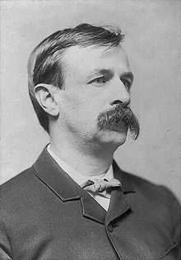
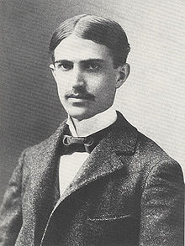



Salwa AL-Hmyani (Introduction)
Amal Wazna (William Dean Howell )
Afnan Abo Al-hassan (Edward Bellamy)
Basma Sawadi (Stephen Crane )
Razan Al-Ali (Frederic’s style, Hamlin Garland and Ambrose Bierce)
Sara Al- Khattabi ( Henry James)

Slide 2

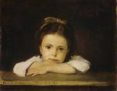
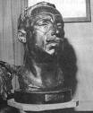

Chapter 7
The Era of Realism and Naturalism
from An Outline of American Literature by Peter B. High

Slide 3
Outline…
Influence of French Realism.
Changed the relationship between literature and society.
Novel had the power to become a political weapon.
In literature, realism gives us a picture of life as it really is.

Slide 4
Naturalism: refers to various topics within philosophy and science, environmental movements, and other areas.
Realism:
A manner of treating subject matter that presents a careful description of everyday life.
A theory of writing in which the ordinary, familiar, or aspects of life are represented in a straightforward manner that is presumed to reflect life as it actually is. (Dictionary.com)

Slide 5
William Dean Howell
(1837-1920)
  Created the first theory for American realism.
  Under him realism became the (mainstream) of American literature.

Slide 6
William Dean Howell
(1837-1920)
  Howell’s put his realist theories into practice in his novels.
  The theme of A Modern Instance (1882),shocked the public.

Slide 7
William Dean Howell
(1837-1920)
  He attacks Romantic nonsense.
  He complains about the power of theses novels to form “the whole intellectual experience” of large number of people.
  Then he goes on to say:“The novelists might be the greatest possible help to us if they painted life as it is, and human feelings in their true proportion and relation.”

Slide 8
William Dean Howell
(1837-1920)
  Howells hated the romantic literature of such popular writers .
  Such novels “ make one forget life and all its cares and duties ”, he wrote.
  Novels “should make you think . . . and shame you into wishing to be a more helpful creature than you are.”

Slide 9
William Dean Howell
(1837-1920)
  The Good realists should be interested in “the common feelings or commonplace people”.
  On the other hand , he felt that authors should not make society look more ugly than it is .
  American novels should depict the “more smiling aspects of life”

Slide 10


William Dean Howell
(1837-1920)
  A Hazard of New Fortunes (1890)
  He became a kind of socialist.
  This outlook made him add anew law to his ideology of realism: art and the artist must serve the poor people of society.
  He began attacking the evils of American capitalism, its selfish competition.

Slide 11
Edward Bellamy (1850-1898)
Edward Bellamy(1850-1898)
Nationality: American.
Occupations: Novelist, Short story writer and a social reformer.
Literary movement:
Realism and Naturalism.

Slide 12
Edward Bellamy (1850-1898)
As many “naturalists "He believed people were not really “free". they controlled by social, economic and physiological causes..
The author propose is really to criticize capitalist America of the 1880s.
Bellamy was sure society's problems could be solved by a higher level of industrialization.

Slide 13
Bellamy’s famous works
Looking Backward
Appeared in(1888)Set in Boston.
The hero, Julian West, falls into sleep and wakes in the year 2000, to find he is living in a socialist utopia where people co-operate rather than compete.
The novel was highly successful and sold over 1,000,000 copies…
Bellamy also had several novels published including The Duke of Stockbridge (1879), Dr. Heidenhoff's
Process (1880) and Miss Ludington's Sister (1884).

Slide 14

Stephen Crane )Naturalism)
The first American naturalist .
He was a genius with amazing sympathy and imagination.
Crane’s characters' are controlled by their environment.
After he wrote Maggie: A girl of the Streets.

Slide 15
Crane’s style
His style is far more exciting.
He uses colors and word-sounds to create brilliant “impressions”.
what is the meaning of impressions?
He was a good poet, wrote a collection of poems called War Is Kind.

Slide 16
The Red Badge of Courage
Another greatest novel The Red Badge of Courage battle wound.
In this novel , he shows that; the world is like a battlefield, which filled with meaningless confusion.
Good, bad, and coward hero are merely a matters of chance , of fate.

Slide 17
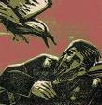
The Open Boat
In this short story, he shows how life and death are determined by fate.

Slide 18
Frederic’s style
The most famous novel that shows the ugly side of America’s common people is
The Damnation of Thereon Ware.
In the society of this novel, he states that; the only religion is “the religion of cash”.

Slide 19
Hamlin Garland
He was naturalism novelist.
His literature was a form of social protest.
He developed a writing method which he called “Veritism”.
His style of his descriptions is often impressionistic like Crane’s.

Slide 20

Ambrose Bierce
He loved to describe terrifying events and strange forms of death.
He like to go deep in details of his stories and he used the element of Irony.

Slide 21
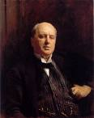
Stream of Consciousness
Henry James Starts it
William James was the one who gave the name.

Slide 22
He was interested in the working of the mind and its responds to strange things.
Psychological realism
In his final novels the characters rarely do anything. Things happened to them than they had to do actions.
This method wasn’t popular at the 19 C. , but at the 20 C. it rises, thanks to modern psychology and writers.

Slide 23
His development divided into 3 stages:
Early
middle
Mature

Slide 24
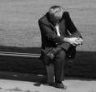
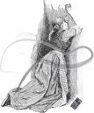
Early life: the novels of that era deals with his thoughts and feelings as an American living in Europe.
The American

Slide 25

Middle life: the beginning of describing the conscious of the characters in the play.
The Portrait of a Lady
The most important part in this novel, when the hereon realizes her mistake by marrying the wrong man. There is great drama in his description of her “motionless seeing”.

Slide 26
The mature period: after the portrait of a lady the dramatic action disappears from James’s novels. Characters divided into two ways:
Characters who spend their time talking about the possibilities of the situation they are in.
Or the changes of the ways of looking to things that could happen to them, and sometimes the changes in believes.
The Ambassadors

Slide 27
Other Themes:
How art changes reality.
Unlived lives.
Introducing children to the evil and immorality of the world around them.
Being an American.

